Slide 1



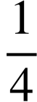
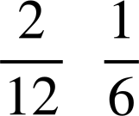
Checking and securing dividing a fraction by a whole number
Task A: Contexts for dividing fractions
1) A pizza is split into 12 equal pieces. A teacher takes 2 pieces and the remaining is given equally between 2 students. What fraction of the whole pizza does each student receive?
Removing 2 pieces means there are 10 pieces left
Dividing these 10 pieces by 2 means each person gets 5 pieces each
This means each person receives
2) There are 14 crayons in a box. Two are lost and the rest are shared equally between a table of 4 students. What fraction of the full crayon box does each student receive?
Removing 2 crayons means there are 12 left
Dividing these 12 pieces by 4 means each person gets 3
This means each person receives
3) A chocolate bar has 24 equal pieces. The teacher eats 6 pieces and shares the rest between 3 students. The teacher says, everyone has had the same fraction of the chocolate bar. Is the teacher correct?
Removing 6 pieces means there are 18 pieces left
Dividing these 18 pieces by 3 means each person gets 6
This means that they all received the same fraction, or of the chocolate bar.
4) A pizza is cut into 4 equal pieces. There are 6 people who need to share the pizza equally. How should the pizza be cut so everyone receives an equal piece? What fraction does each person receive?
Cut each ¼ into 3 pieces
This means there are 12 pieces
Each person then gets
Which is the same as

Slide 2
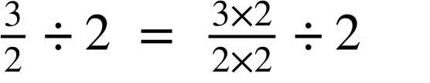
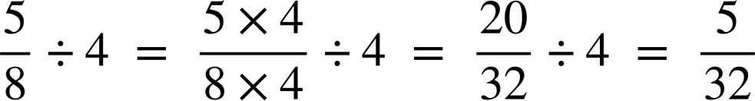
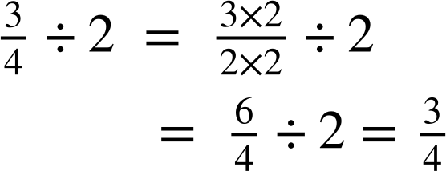
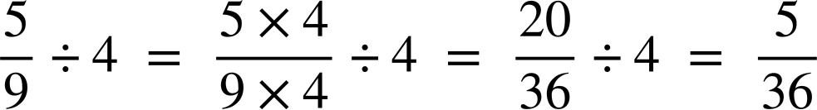
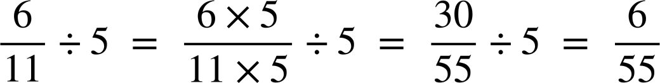
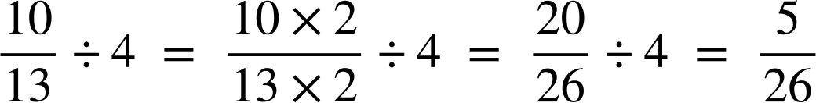
Checking and securing dividing a fraction by a whole number
Task B: Dividing any fraction by a whole number
1) Match the questions and answers
2) Work out the answers to the following. You can draw bar models if needed.
a)
b)
c)
d)
3) Jacob has used equivalent fractions to work out his answer but has spilt ink all over his work. Can you identify what his missing numbers were?
a)
b)
4) Work out the answers to the following, giving your answer in its simplest form.
a)
b)
c)
Mathematics in Education and Industry.

